Slide 1
AUTOMATIC DOCUMENT CLASSIFIER
NABEEL E P
35
PRODUCT OWNER-Mr. MUHAMMED JABIR

Slide 2
TABLE OF CONTENTS
Introduction
Modules
Data Flow Diagram
Table Design
Developing Environment
User Stories
Product Backlog
Project Plan
Sprint Plan
Sprint Backlog
Sprint Actual

Slide 3
INTRODUCTION
The classification is a grouping procedure which allows us to group a set of data according to a selected criterion. Generally, the objects or data of the same group share similar characteristics with one another, while the objects of different groups will have less similarity among them. For example, in an organization the documents can be classified by a functional criterion, that is to say, grouping the documents by activities inside the company, or through a criterion of hierarchical order, where the managers have access to different documents that employees have access to. The goal in the task of classification is to locate the document of an appropriate class.
Having a large number of features makes the classification process to be computationally expensive and that the classes not being well defined. The feature selection focuses on reducing the dimensionality, many approaches concentrate on considering only one subset of features extracted from text. Generally, for the selection of characteristics we have techniques based in the collection of documents and techniques based in typifying each class

Slide 4
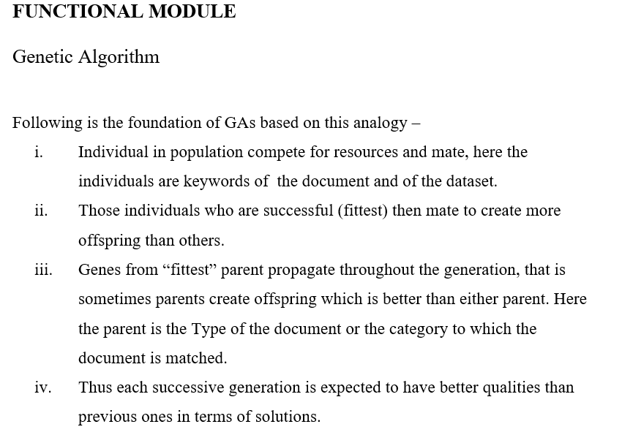

Slide 5
MODULES
Admin
Verify the user.
Reply to messages.
Add datasets.
STUDENT
Send and receive messages.
Upload documents.
View category.
Identify duplicate documents.
View history.
Display documents under different categories.

Slide 6
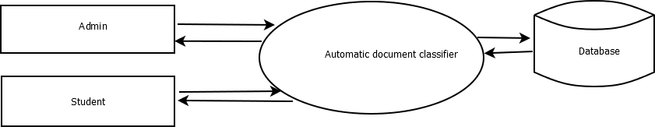
Level 0

Slide 7
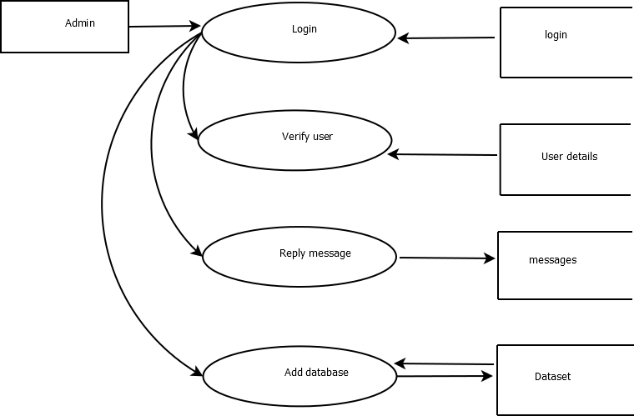
Level 2

Slide 8
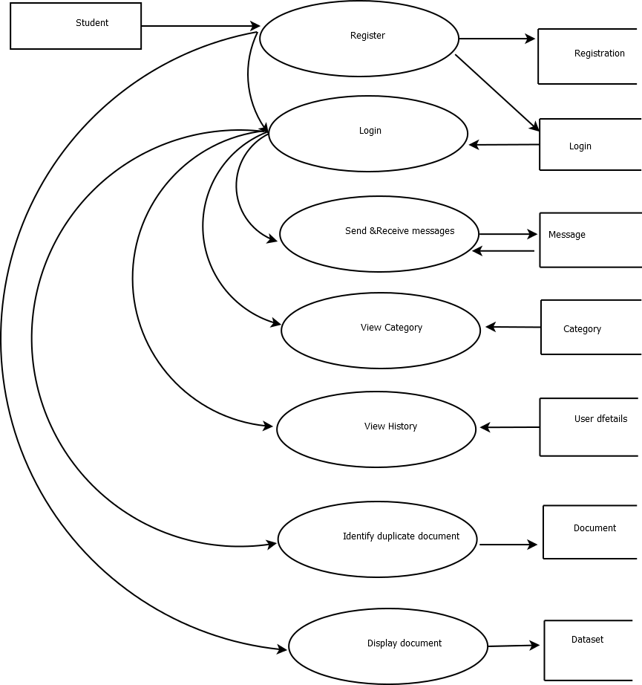
Level 2

Slide 9
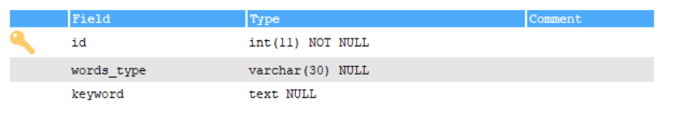
Login
Dataset

Slide 10
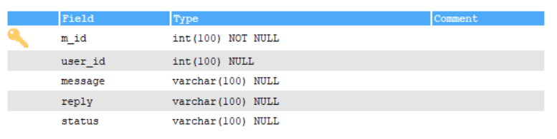
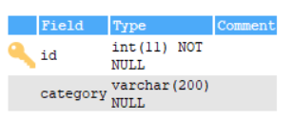
Massages
Category

Slide 11
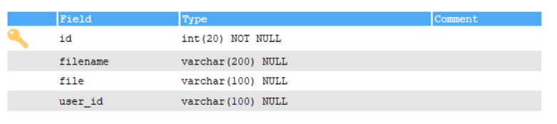
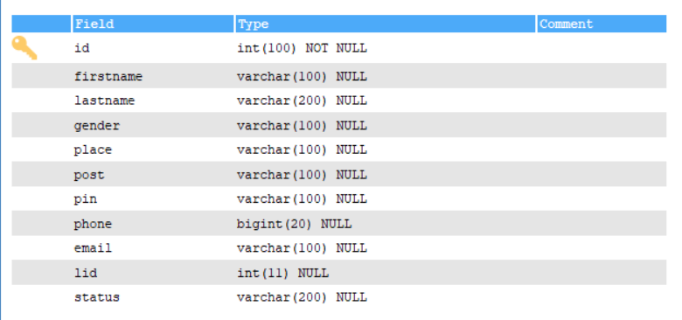
Documents
User Details

Slide 12
DEVELOPING ENVIRONMENT
Hardware Requirements
Input Device : Mouse, Keyboard
Output Device : Monitor
Memory : 4 Gb Ram(Minimum)
Processor : Intel core i3 or above
Software Requirements
Operating System : Windows 8 /10 for Better Performance
Front End : Python (Flask)
Back End : Mysql
Software Used : Pycharm
Web Browser :Internet Explorer/Google Chrome/Firefox(for web application)

Slide 13
USER STORIES
User StoryID | As a <type of user> | I want to | So that I can
1 | Admin | login | login successful with correct username and password
2 | Admin | View users | view users
3 | Admin | verify users | accept and reject users
4
5
6
7
8
9
10
11
12
13
14
15
16
17 | Patient | View claim status | View status of request

Slide 14
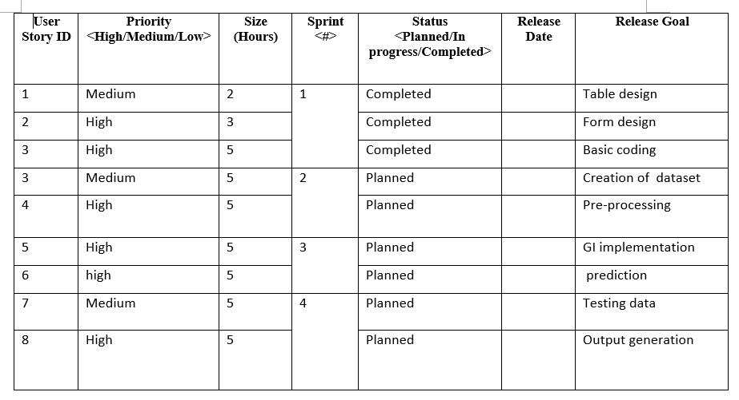
Product Backlog

Slide 15
PROJECT PLAN
User Story ID | Task Name | Start Date | End Date | Days | Status
1 | Sprint 1 | 26/12/2021 | 28/12/2021 | 2 | Completed
2 |  | 29/12/2021 | 31/12/2021 | 3 | Completed
3 |  | 03/12/2021 | 08/01/2022 | 5 | Completed
4 | Sprint 2 | 09/01/2022 | 16/01/2022 | 8 | Planned
5 |  | 18/01/2022 | 22/01/2022 | 5 | Planned
6 | Sprint 3 | 23/01/2022 | 27/01/2022 | 5 | Planned
7 |  | 30/01/2022 | 05/02/2022 | 7 | Planned
8 | Sprint 4 | 06/02/2022 | 10/01/2022 | 5 | Planned
9 |  | 16/02/2022 | 19/02/2022 | 4 | Planned

Slide 16
SPRINT BACKLOG PLAN
Backlog Item | Status & completion date | Original estimate in hours | Day1 | Day2 | Day3 | Day4 | Day5 | Day6 | Day7 | Day8 | Day9 | Day10 | Day11 | Day12 | Day13 | Day14
User story #1,#2,#3,#4 |  | hrs | hrs | hrs | hrs | hrs | hrs | hrs | hrs | hrs | hrs | hrs | hrs | hrs | hrs | hrs
Table design | 28/12/2021 | 2 | 1 | 1 | 0 | 0 | 0 | 0 | 0 | 0 | 0 | 0 | 0 | 0 | 0 | 0
Form design | 31/12/2021 | 3 | 0 | 0 | 0 | 1 | 1 | 1 | 0 | 0 | 0 | 0 | 0 | 0 | 0 | 0
Basic coding | 08/01/2021 | 5 | 0 | 0 | 0 | 0 | 0 | 0 | 0 | 0 | 0 | 1 | 1 | 1 | 1 | 1
Creation of dataset | 16/01/2022 | 5 | 1 | 1 | 0 | 1 | 0 | 1 | 0 | 1 | 0 | 0 | 0 | 0 | 0 | 0
Pre-processing | 22/01/2022 | 5 | 0 | 0 | 0 | 0 | 0 | 0 | 0 | 0 | 0 | 1 | 1 | 1 | 1 | 1
GI implementation | 27/01/2022 | 5 | 1 | 1 | 1 | 1 | 1 | 0 | 0 | 0 | 0 | 0 | 0 | 0 | 0 | 0
Prediction | 05/02/2022 | 5 | 0 | 0 | 0 | 0 | 0 | 0 | 0 | 1 | 0 | 1 | 1 | 1 | 0 | 1
Testing Data | 10/01/2022 | 5 | 1 | 1 | 1 | 1 | 1 | 0 | 0 | 0 | 0 | 0 | 0 | 0 | 0 | 0
Output generation | 20/02/2022 | 5 | 0 | 0 | 0 | 0 | 0 | 0 | 0 | 0 | 0 | 2 | 1 | 1 | 1 | 1
Total |  | 40 | 4 | 4 | 2 | 4 | 3 | 2 | 0 | 2 | 0 | 5 | 4 | 4 | 3 | 4

Slide 17
SPRINT ACTUAL
Backlog Item | Status & completion date | Original estimate in hours | Day1 | Day2 | Day3 | Day4 | Day5 | Day6 | Day7 | Day8 | Day9 | Day10 | Day11 | Day12 | Day13 | Day14
User story #1,#2,#3,#4 |  | hrs | hrs | hrs | hrs | hrs | hrs | hrs | hrs | hrs | hrs | hrs | hrs | hrs | hrs | hrs
Table design | 28/12/2021 | 3 | 1 | 1 | 0 | 0 | 0 | 0 | 0 | 0 | 0 | 0 | 0 | 0 | 0 | 0
Form Design | 31/12/2021 | 2 | 0 | 0 | 0 | 1 | 1 | 1 | 0 | 0 | 0 | 0 | 0 | 0 | 0 | 0
Basic coding | 08/01/2021 | 5 | 0 | 0 | 0 | 0 | 0 | 0 | 0 | 0 | 0 | 1 | 1 | 1 | 1 | 1
Creation of dataset
Pre-processing
GI implementation
Prediction
Testing data
Output generation
Total |  | 10 | 1 | 1 | 0 | 1 | 1 | 1 | 0 | 0 | 0 | 1 | 1 | 1 | 1 | 1

Slide 18
THANK YOU

